Slide 1
Innovative circular solutions and services for new business opportunities in the EU housing sector
CCHE Steering Board – 23rd April 20

Slide 2
Content
General project information
Background
Main goal and scope
WP structure and tasks review

Slide 3
General project information
Topic H2020-CIRC-01-2016-2017: Systemic, eco-innovative approaches for the circular economy: large-scale demonstration projects
- 54 Months duration
(1st May 2018 – 31st December 2022)
- 16 partners – 8 countries
- Budget: 8,535,247€
CCHE Steering Board 23rd April 2020

Slide 4
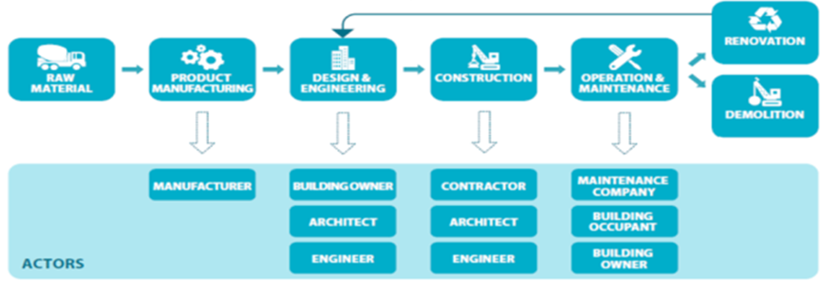
Background
CURRENT HOUSING SECTOR (Linear Model)
MAIN PROBLEMS:
10-15% of building material is wasted during construction;
50% of residential dwellers report living in too much space
20-40% of energy in existing buildings can be profitable conserved
Electricity consumption per capita in the residential sector in the EU-28 in 2014 was 1.5MWh per capita (1549 kWh)
173 kg of food waste production per person and year, externally managed
80-150L wastewater production at household level per capita and day
54% of demolition materials landfilled, while some countries only landfill 6%.
CCHE Steering Board 23rd April 2020

Slide 5
Background
CURRENT HOUSING SECTOR (Linear Model)
These negative environmental impacts result form the linear ‘take, make, dispose’ model.
The building lifetime covers a minimum of 40-60 years. Then, not properly planned decisions definitively affect the functionality of the whole utility, related housing practices and lifestyles of dwellers during several generations.
Transition from a linear to a circular business economy is being implemented at industrial scale. A large number of case studies and projects are focused on the new design of products, smart production in industries and energy efficiency processes.
This transition has not yet taken place at all levels in the housing sector (energy, water, waste and materials).
CCHE Steering Board 23rd April 2020

Slide 6
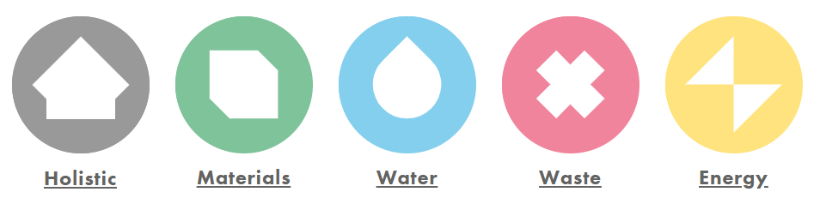
Main goal and scope
The main goal of the HOUSEFUL project is to develop and demonstrate an integrated systemic service (HOUSEFUL Service) composed of 11 circular solutions co-created by stakeholders in current housing value chain.
The HOUSEFUL Service will aim at the circular management and efficient use of water, waste, energy and material resources for all stages of European building’s life-cycle.
The integrated systemic service will be presented as an on-line Software as a Service (SaaS), enabling the replication of proposed circular solutions offered to stakeholders as Circular Economy Business Opportunities (CEBOs) at EU level: renting, leasing, customer service, capacity building service and/or combination of them.
CCHE Steering Board 23rd April 2020

Slide 7
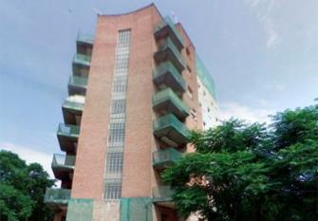
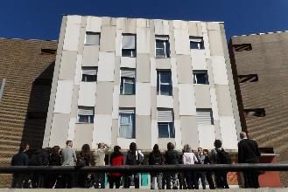
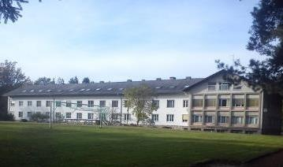
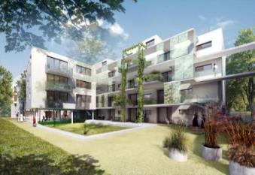




Main goal and scope
demo 1 – OLD BUILDING (60’s)
demo 2 – OLD BUILDING (90’s)
Demo 3 – centenary building
Demo 4 – NEW BUILDING (2017)
Solutions:
S1
S2
S3
S4
S6
S7
S8
S9
S10
Solutions:
S4
S9
S11
S1
S2
S3
S4
S5
S9
S10
S1
S2
S3
Solutions:
S7
S8
S9
S10
S11
Solutions:
S1
S2
S3
S4
S5
Sabadell, Edifici “Els Mestres”
Sant Quirze del Vallès
Cambium - Military building
Vienna , Donaufelder Straße 115
Services demonstrated: EPP / E / M / WW
Services demonstrated: EPP / E / M / BW / WW
Services demonstrated: EPP / E / M / BW / WW
Services demonstrated: EPP / E / M
EVALUATION AND INTEGRATION IN frontrunner BUILDINGS
External Advise and collaboration with:
Software as a Service (SaaS)
CCHE Board
Web-based interactive site for co-creation and replication of HOUSEFUL services
10
FOLLOWER BUILDINGS
REPLICATION
CCHE Steering Board 23rd April 2020

Slide 8
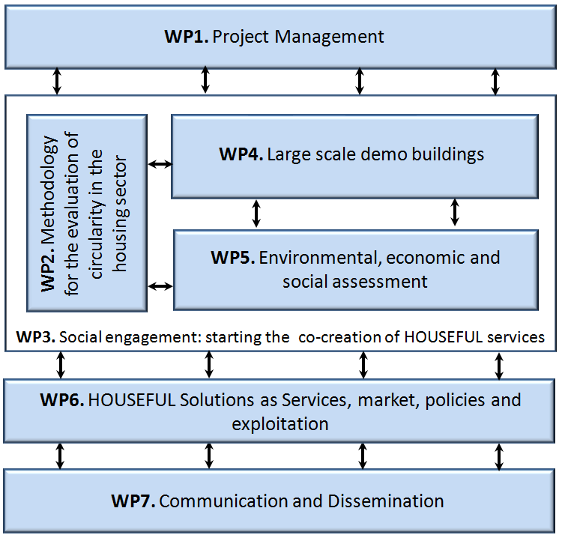



WP structure and tasks review
CCHE Steering Board 23rd April 2020

Slide 9
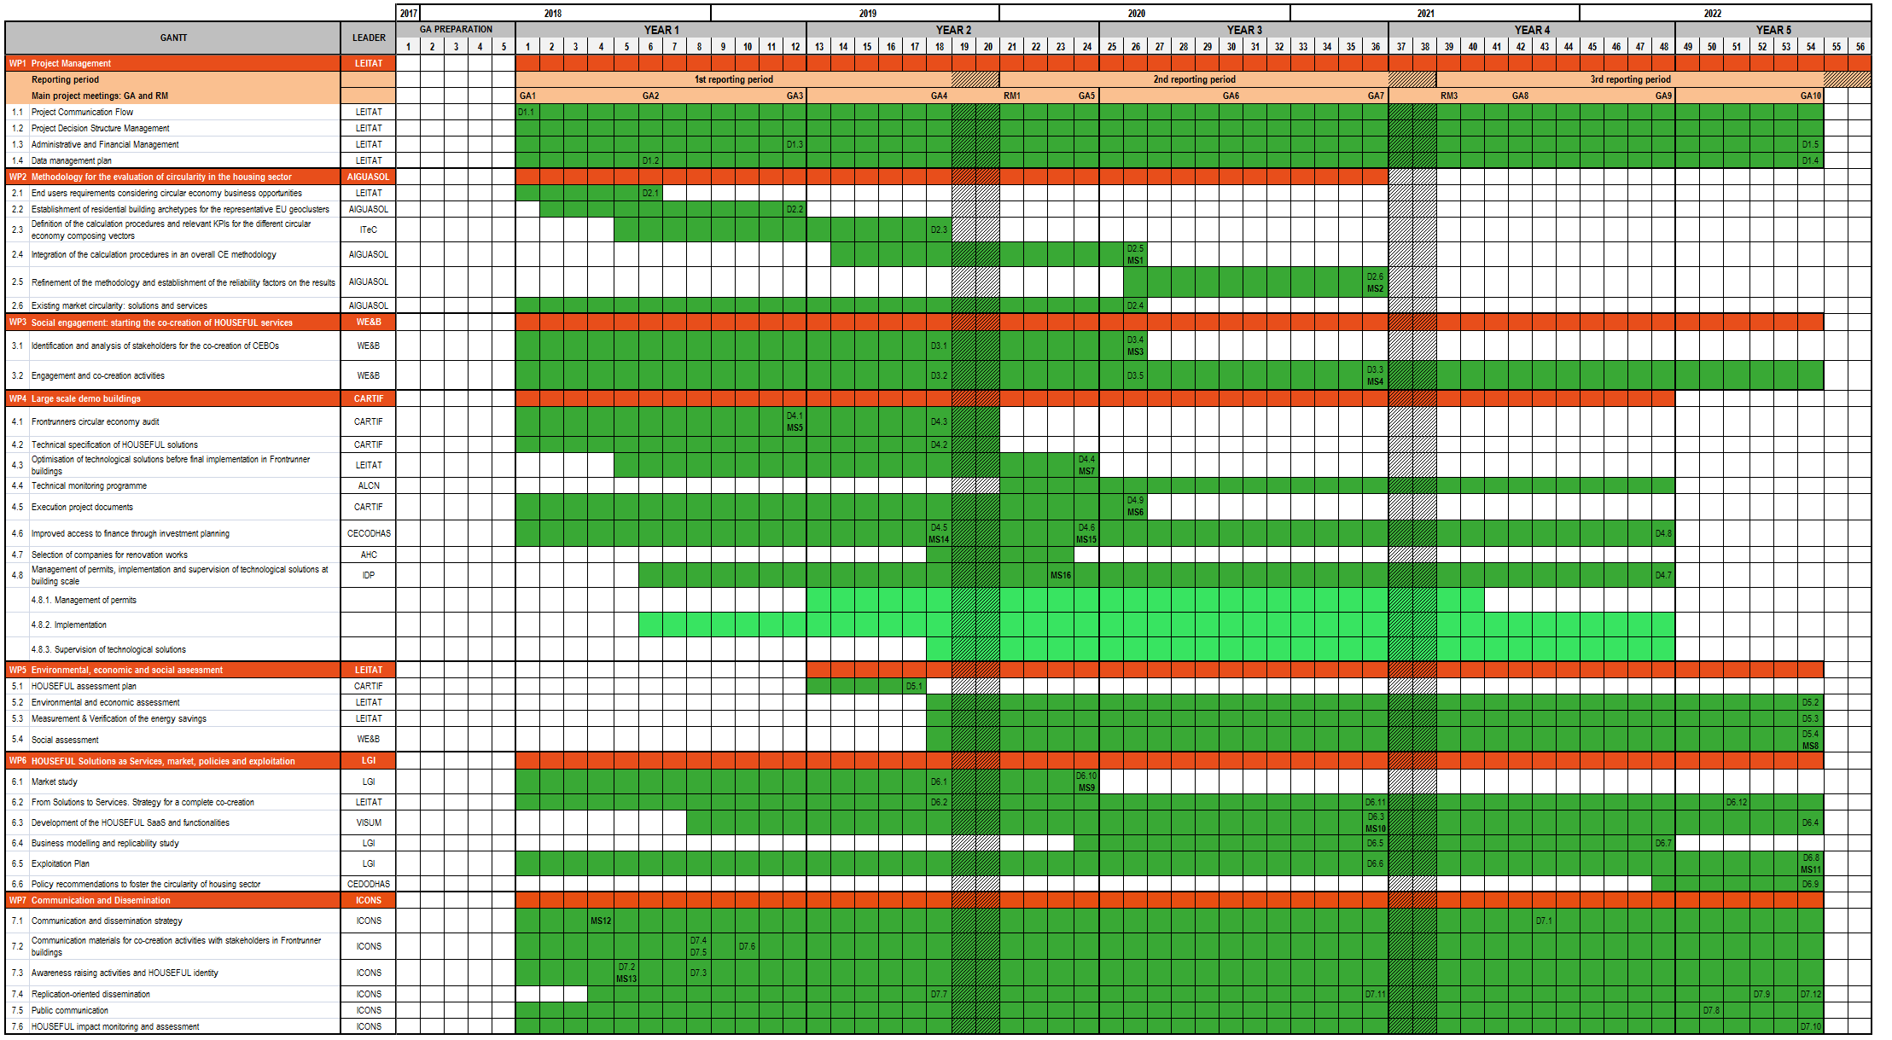
WP structure and tasks review
CCHE Steering Board 23rd April 2020

Slide 10







Challenge 3
Challenge 4
Challenge 5
Challenge 1
Challenge 2
The HOUSEFUL Service will benefit the following stakeholders, which will be also involved in the co-creation process of HOUSEFUL solutions:
Challenge 1
To redesign new business models of the housing value chain from linear to circular economy that underpin new services based on performance/functionality rather than ownership.
Challenge 2
Need of a robust, standardized, reliable and day-to-day market usable methodology to quantify the degree of circularity of buildings considering the potential retrofit at different levels, both pre- and post-refurbishment, which could be used by stakeholders such as designers, promoters, financial institutions or dwellers.
Challenge 3
To guarantee the environmental, economic and social feasibility of different circular existing and innovative solutions (TRL 6 to 8) before final co-creation of services by applying a life cycle thinking approach
Challenge 4
Overcoming cultural and social barriers for the effective co-creation and acceptance of new circular economy business opportunities designed for the circular management and use of water, waste, energy and material resources.
Challenge 5
Providing policy recommendations, guidelines and tools able to enable the current framework conditions in housing sector for a broader transition to a circular economy in the EU.
CCHE Steering Board 23rd April 2020

Slide 11
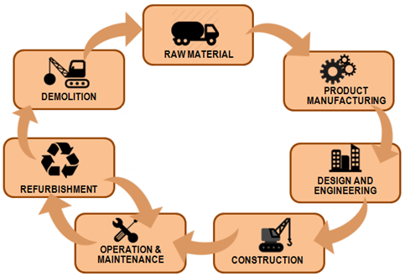

Main goal and scope
MAIN OUTPUTS:
30% reduction of Waste destined to landfills.
50% improvement of non primary energy consumption and energy efficiency by passive and active measures.
Best selection of materials for Efficient process and procedures and passive measures on Energy.
Minimising 50% of bio-waste. Once produced, >95% recovery by efficient separation and biogas production.
Recycling >90% of rainwater, greywater and black-water for production of reclaimed water and biogas.
High quality compost from digestate.
Alternative CHP from biogas at home level.
CCHE Steering Board 23rd April 2020

Slide 12
Thank you!
Daniel Checa Alias
dcheca@leitat.org

